Slide 1
Local optimizations, DCE, and LVN framework
Prof. 廖世偉, liao@csie.ntu.edu.tw
Read Dragon Book: 8.4-8.5, 6.2.4

Slide 2

Learning-by-doing in today’s class:
Example:
https://www.youtube.com/watch?v=YhmCG8S5umc

Slide 3

Reminder: Simple quiz at the end of class today; No need to turn in your answer.
Each time I’ll record the answer for you in a week.
BTW, each week’s lecture is also recorded. Just watch it at your pace.
Though you don’t need to come to class per se, your attendance will benefit yourself: 儀式感很重要:

Slide 4
Local vs. Data-flow Analysis
Local Analysis
Analyze effect of each instruction
Compose effects of instructions to derive information from beginning of basic block to each instruction
Data-flow Analysis
Analyze effect of each basic block
Compose effects of basic blocks to derive information at basic block boundaries

Slide 5
Intra-procedural and Interprocedural analysis
Intra-procedural analysis:
Local analysis: Within a single basic block.
Don’t deal with control flow. Just “linear scan”.
Global analysis: Works on an entire function
Interprocedural analysis:
Works on an entire program
Because “intra-procedural” and “interprocedural” sound similar, from now on we use “local and global analysis” instead of “intra-procedural analysis”.
main {
a: int = const 4;
c: int = const 1;
print a;
}
call

Slide 6
Dead Code Elimination (DCE) in BRIL
“c: int = const 1;” is dead code here:
How about this?
Show me the dead code. Again, “c: int = const 1;” is dead code.
“Dead code” = Can’t have any possible effect on the output of a program.
Dead code elimination (DCE) makes the program run faster!
Dynamic instruction count goes down from 5 to 4.
main {
a: int = const 4;
c: int = const 1;
print a;
}
main {
a: int = const 4;
b: int = const 2;
c: int = const 1;
d: int = add a b;
print d;
}

Slide 7
Bril: A Compiler Intermediate Representation for Learning
Bril, the Big Red Intermediate Language, is a programming language for learning about compilers. It’s the intermediate representation in Cornell’s CS 6120, a PhD-level compilers course. Bril’s design tenets include:
Bril is an instruction-oriented language, like most good IRs.
The core is minimal and ruthlessly regular. Extensions make it interesting.
The tooling is language agnostic. Bril programs are just JSON.
Bril is typed.

Slide 8
Write pseudo code on how to do DCE:
First, what’s the algorithm?
Iterate through all the instructions in a given basic block: Eliminate an instruction whose destination:
is never used as an instruction’s argument and
is NOT live at the exit of the given basic block.
Such an instruction is called Dead Code.
Note: Liveness is a global property.
Remember the Data Flow analysis

Slide 9
Algorithm: Use 2 loops below.
used = {}
for inst in a func:
used += instr.args
for inst in a func: // Here we only delete those “pure” instructions with unused dest
if instr.dest and instr.dest is NOT in used :
delete inst
// Impure instructions such as print instruction have side effects.
// In BRIL, impure instructions won’t have “.dest”, so print instruction is never deleted above.

Slide 10
Is this algorithm enough?
Considering this case: (Let’s add the instruction “e: int = add c d”)
Our 2-loop algorithm above is still correct, but sub-optimal.
2-loop algorithm will only delete “e: int = add c d”
But how about deleting “c: int = const 1”?
Obviously the 2-loop algorithm is insufficient. The algorithm should iterate until it converges.
main {
a: int = const 4;
b: int = const 2;
c: int = const 1;
d: int = add a b;
e: int = add c d;
print d;
}

Slide 11
Key Concept: Iterative algorithm in compilers
while program changed:
run DCE (the 2-loop algorithm) above

Slide 12
Is this algorithm enough?
Considering this case:
We addressed the write-read dependence in the previous slides. But how about write-write dependence here?
First, now we need to care about the ordering of instructions.
DCE in the presence of control flow is challenging! See:
So we now resort to local DCE from now on:
main {
a: int = const 100;
a: int = const 42:
print a;
}
main {
a: int = const 100;
br input .l .k;
.l:
a: int = const 42:
.k:
print a;
}

Slide 13
Local DCE:
last_def_without_any_use_yet = {} // mapping from variable -> instr
for instr in block:
// check for uses
last_def_without_any_use_yet -= instr.args
// check for defs
if instr.dest in last_def_without_any_use_yet:
delete last_def_without_any_use_yet[inst.dest] // Dead code elimination here
last_def_without_any_use_yet[instr.dest] = instr
Notes:
This is only a Python-like pseudo code, you should implement the check and elimination yourself.

Slide 14
To understand “brili” vs. “brili -p”, see https://capra.cs.cornell.edu/bril/tools/interp.html

Slide 15
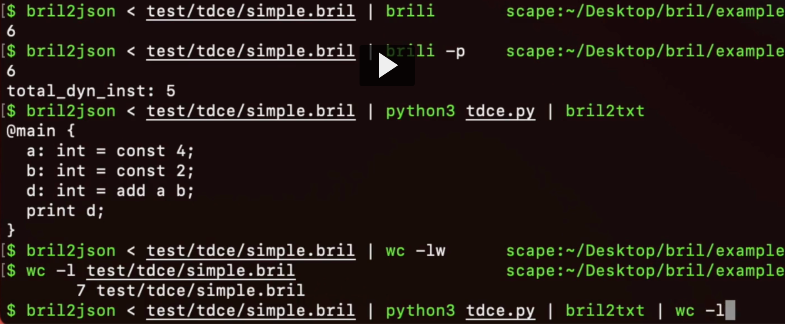
For these 2 passes above:
simple.bril:
main {
a: int = const 4;
b: int = const 2;
c: int = const 1;
d: int = add a b;
print d;
}
Iterate them until convergence.
Once converged, wc -l returns 6 instead of 7.
Notes:
llvm-as, llvm-dis

Slide 16
Run the bril interpreter (brili): We care about the DIC:
$ bril2json < simple.bril | python3 tdce.py | brili -p
6
total_dyn_inst: 4
Total dynamic instruction count (DIC) = 4 instead of 5.
Success in DCE.

Slide 17
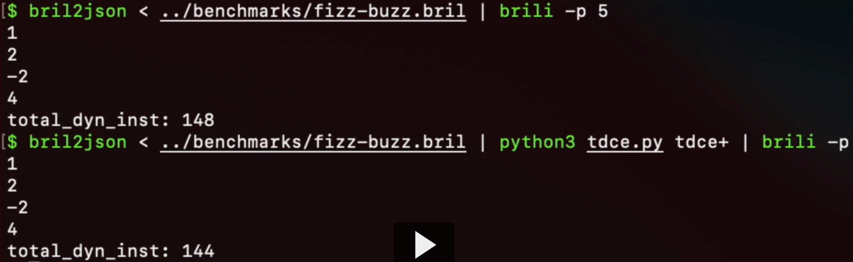
More real case:
Reduce 148 instructions to 144 instructions:

Slide 18
Recap: Dead Code Elimination Algorithm
Globally unused instructions:
Derive an algorithm for deleting them.
Iterating to convergence.
Then we implement it.
Locally killed instructions:
Caveat: Be aware of the limits of local reasoning: Why can't we do this globally?
Derive an algorithm for removing them.
Then we implement that too.

Slide 19
Local Value Numbering (LVN) framework:
Unifying framework for:
DCE
Copy propagation
Constant propagation
Common Subexpression Elimination (CSE)
When free, please watch the video on Local Value Numbering:
https://www.cs.cornell.edu/courses/cs6120/2020fa/lesson/3/
If you’re wonderful, feel free to do the tasks (Cornell website says: “due September 21”, but you don’t need to turn it in. It’s optional.)

